Slide 1
BLOOD RELATION

Slide 2
Relations of Paternal side:-
Father's father → Grandfather
Father's mother → Grandmother
Father's brother → Uncle
Father's sister → Aunt
Children of uncle → Cousin
Wife of uncle → Aunt
Children of aunt → Cousin
Husband of aunt → Uncle

Slide 3
Relations of Maternal side:-
Mother's father → Maternal grandfather
Mother's mother → Maternal grandmother
Mother's brother Maternal uncle
Mother's sister →Aunt
Children of maternal uncle → Cousin
Wife of maternal uncle → Maternal aunt

Slide 4
Important Relations to understand:-
Mother’s or Father’s daughter » Sister
Mother’s or Father’s son » Brother
Grandfather’s son » Father or Uncle
Grandmother’s son » Father or Uncle
Grandfather’s daughter » Mother or Aunt
Grandmother’s daughter » Mother or Aunt
Paternal Grandfather’s or Grandmother’s only son » Father
Maternal Grandfather’s or Grandmother’s only daughter » Mother

Slide 5
Important Relations to understand:-
Maternal Grandfather’s or Grandmother’s only son-in-law » Father
Paternal Grandfather’s or Grandmother’s only daughter-in-law » Mother
Paternal aunt’s or uncle’s only brother » Father
Maternal aunt’s or uncle’s only sister » Mother
Mother’s or father’s mother » Grandmother
Son’s wife » Daughter-in-Law
Daughter’s husband » Son-in-Law
Husband’s or wife’s father » Father-in-Law
Husband’s or wife’s mother » Mother-in-Law

Slide 6
Important Relations to understand:-
Husband’s or wife’s sister » Sister-in-Law
Husband’s or wife’s brother » Brother-in-Law
Brother’s son » Nephew
Brother’s daughter » Niece
Uncle or aunt’s son or daughter » Cousin
Sister’s husband » Brother-in-Law
Brother’s wife » Sister-in-Law
Grandson’s or granddaughter’s daughter » Great grand daughter
Grandson’s or granddaughter’s son » Great grand son

Slide 7
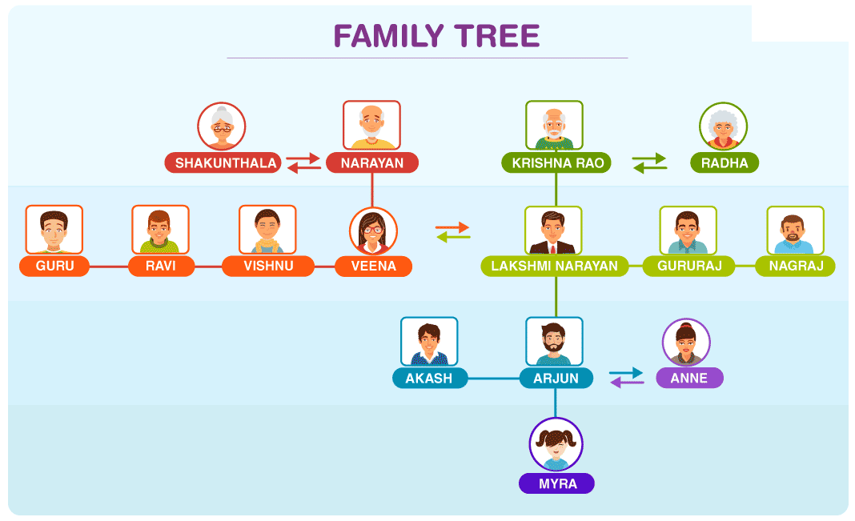
SYMBOLS

Slide 8
TYPE I
Pointing to a photograph, Rekha says to Bindu, "The girl in the photo is the second daughter of the wife of only son of paternal grandmother of my younger sister." How this girl of photograph is related to Rekha ?

Slide 9
1. Pointing to a photograph of a boy Suresh said, "He is the son of the only son of my mother." How is Suresh related to that boy?
A. Brother B. Uncle C. Cousin D.Father

Slide 10
2.Pointing towards a person in a photograph, Aakansha said, “ He is the only son of the father of my sister’s brother.” How is that person related to Aakansha ?
a. Paternal uncle b. Father c. Mother d. Brother

Slide 11
3.Pointing towards a woman in a photograph, Vijay said, “She is the daughter of the father of the sister of my brother”. How is the lady in photograph related to Vijay?”
a. Mother b. Wife c. Daughter d. None of these

Slide 12
4. Pointing to a photograph. Ritesh said, "He is the son of the only daughter of the father of my brother." How Ritesh is related to the man in the photograph?
A. Nephew B. Brother C. Father D.Maternal Uncle

Slide 13
Pointing to a woman in photograph a man says,” she is the only daughter of my wife’s mother in law”. How is the woman related to the man?
Sister
Aunt
Mother
Wife
None of these

Slide 14
TYPE II
Example:- 15 If,
A + B means A is the mother of B
A x B means A is the father of B
A $ B means A is the brother of B
A @ B means A is the sister of B
then which of the following means P is the son of Q?
a) Q + R @ P @ N b) Q + R x P @ N
c) Q x R $ P @ N d) Q x R $ P $ N

Slide 15
Example:- 16 If A + B means A is the mother of B; A - B means A is the brother B; A % B means A is the father of B and A x B means A is the sister of B, which of the following shows that P is the maternal uncle of Q?
a) Q - N + M x P b) P + S x N – Q c) P - M + N x Q d) Q - S % P

Slide 16
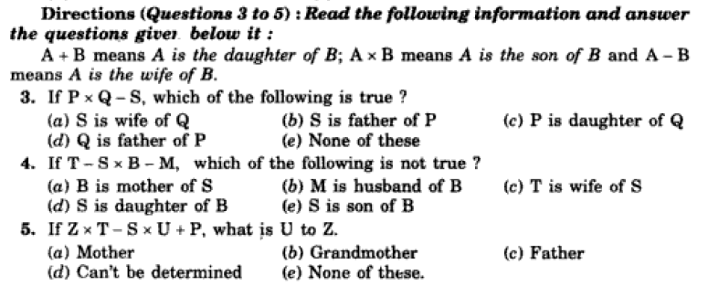

Slide 17
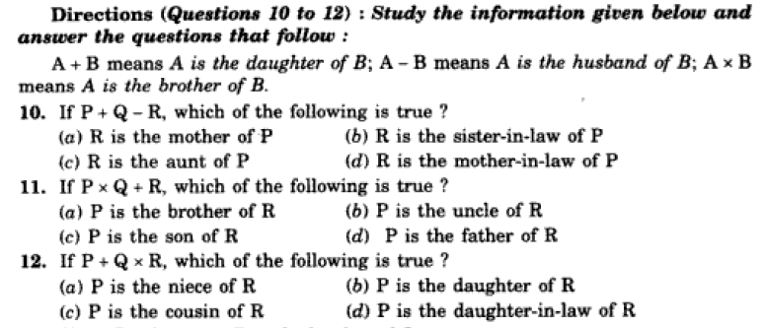

Slide 18
TYPE III
A is the son of C; C and Q are sisters; Z is the mother of Q and P is the son of Z. How is P related to A ?

Slide 19
Direction for Examples:- (12-14)
A is the father of C but C is not his son. E is the daughter of C. E is the spouse of F. B is the brother of C. D is the son of B. G is the spouse of B. H is the father of G.
Example:- 12 How is A related to E ?
Example:- 13 How is D related to E ?
Example:- 14 How is H related to D ?

Slide 20
Q : If A is the brother of B, C is the mother of B, D is the daughter of A, E is the sister of B, F is the brother of D, then who among the following is the Aunt of F?
A b. E c. D d. B

Slide 21
A, B, C, D, E, F and H are family members related to each other. A is the father of D who is brother of F. E is husband of H. F is sister of E. B is son of D and husband of C. How is E related to B?
Father
Son
Uncle
Brother
None of these

Slide 22
There are seven members in a family A, B, C, D, E, F & G in a family of three-generations and either both or none of the parents are alive. B is the son of G. A is the sister in law of F. A has no siblings. G is the mother of F. E has two children. C is the nephew of F. D is the son of A. How is E related to F?
Son
Father
Brother
Sister
None of these

Slide 23
A, B, C, D, and F are members of a family. There are two married couples. B is a psychologist and the father of E. F is the grandfather of C and is a manager. A is the daughter in law of D. D is the grandmother of E and is a housewife. E and C are students. B is the son of D, but D is not the father of B. There is one psychologist, one manager, one doctor, one housewife and two students in the family. How is doctor related to students?
a) Son b) Father c) Brother d) Sister
e) None of these

Slide 24
NUMBER RANKING

Slide 25
Q7. Raman ranks sixteenth from the top and forty-ninth from the bottom in a class. How many students are there in the class ?
(a) 64
(b) 65
(c) 66
(d) Cannot be determined
(e) None of these

Slide 26
Q8. If Atul finds that he is twelth from the right in a line of boys and forth from the left, how many boys should be added to the line such that there are 28 boys in the line ?
(a) 12
(b) 13
(c) 14
(d) 20
(e) None of these

Slide 27
Q9. Manish ranked sixteenth from the top and twenty-ninth from the bottom among those who passed an examination. Six boys did not participate in the competition and five failed in it. How many boys were there in the class?
(a) 40
(b) 44
(c) 50
(d) 55
(e) 58

Slide 28
Q10. Ravi is 7 ranks ahead of Sumit in a class of 39. If Sumit’s rank is seventeenth from the last, what is Ravi’s rank from the start?
(a) 14th
(b) 15th
(c) 16th
(d) 17th

Slide 29
Q14. In a row of boys, Rajan is 10th from the right and suraj is 10th from the left. When Rajan and Suraj interchange their positions, Suraj will be 27th from the left. Which of the following will be Rajan's position from the right?
10th
26th
29th
25th
None of these

Slide 30
Q15. There are 25 boys in horizontal row. Rahul was shifted by three places towards his right side and he occupies the middle position in the row. What was his original position from the left end of the row?
15th
16th
12th
10th
None of these

Slide 31
Q19. Some boys are sitting in a row. P is sitting fourteenth from the left and Q is seventh from the right. If there are four boys between P and Q, how many boys are there in the row ?
A. 25
B. 23
C. 21
D. 19

Slide 32
Q21. In a class of 60, where girls are twice that of boys, Kamal ranked seventeenth from the top. If there are 9 girls ahead of Kamal, how many boys are after him in rank ?
A. 3
B. 7
C. 12
D. 23
E. 32

Slide 33
Sequential Order

Slide 34
Ashish leaves his house at 20 minutes to seven in the morning, reaches Kunal's house in 25 minutes, they finish their breakfast anither 15 minutes and leave for their office which takes another 35 minutes. At what time do they leave Kunal's house to reach their office?
A. 7.40 a.m.
B. 7.20 a.m.
C. 7.45 a.m.
D. 8.15 a.m.
E. 7.55 a.m.

Slide 35
Ajay left home for the bus stop 15 minutes earlier than usual. It takes 10 minutes to reach the stop. He reached the stop at 8.40 a.m. What time does he usually leave home for the bus stop?
A. 8.30 a.m.
B. 8.45 p.m.
C. 8.55 a.m.
D. Data inadequate
E. None of these

Slide 36
Reaching the place of meeting on Tuesday 15 minutes before 8.30 hours, Anuj found himself half an hour earlier than the man who was 40 minutes late. What was the scheduled time of the meeting?
A. 8.00 hrs
B. 8.05 hrs
C. 8.15 hrs
D. 8.45 hrs

Slide 37
Directions: Read the following information carefully and answer the questions that follow: Five plays A, B, C, D and E are to be staged from Monday to Friday of a week. On each day, only one play will be staged. D or E should not be either the first or last to be staged. E should be immediately followed by C. B should be staged immediately after D. One play is staged between A and B.

Slide 38
1. Which is the first play to be staged?
(a) A
(b) B
(c) C
(d) Cannot be determined
(e) None of these
2. Which of the following is the correct sequence of staging all the plays?
(a) ADB CE
(b) AECD B
(c) BDAEC
(d) D BECA
(e) None of these
3. Which play was staged on Wednesday?
(a) A
(b) B
(c) Either B or C
(d) Cannot be determined
(e) None of these

Slide 39
Six lectures A, B, C, D, E and F are to be organised in a span of seven days - from Sunday to Saturday, only one lecture on each day in accordance with the following:
(i) A should not be organised on Thursday.
(ii) C should be organised immediately after F.
(iii) There should be a gap of two days between E and D.
(iv) One day there will be no lecture (Friday is not that day), just before that day D will be organised.
(v) B should be organised on Tuesday and should not be followed by D.

Slide 40
1. On which day there is no lecture?
(a) Monday (b) Friday (c) Sunday (d) Cannot be determined (e) None of these
2. How many lectures are organised between C and D ?
(a) None (b) One (c) Two (d) Three (e) None of these
3. Which day will the lecture F be organised?
Thursday (b) Friday (c) Saturday (d) Sunday
(e) None of these
4. Which of the following is the last lecture in the series?
(a) A (b) B (c) C (d) Cannot be determined
(e) None of these
5. Which of the following informations is not required in finding the complete sequence of organisation of lectures ?
(a) (i) only (b) (ii) only (c) (i) and (ii) only (d) (v) only
(e) All are required

Slide 41
Six films, P, Q, R, S, T and U - are to be released on consecutive Fridays. The schedule of the release is to be in accordance with the following conditions:
(i) P must be released a week before T.
(ii) R must not be released immediately after the first release.
(iii) Q must be released on the Friday following the Friday on which U is released.
(iv) S must be released on fifth Friday and should not be immediately preceded by Q.
(v) T must not be released in the last.

Slide 42
1. Which of the following​​ Movie​​ preceded T?
a) S b) U​​ c) P d) Q
2. In between which of the two​​ Movies S is to be released
a) Q and T​​ b) R and T​​ c) T and U d) P and T
3. Which of the following​​ Movie​​ released first?
a) R b) Q c) P d) U
4. Which of the following​​ Movie​​ released immediately after Q?
a) P​​ b) R​​ c) U d) T
5. Movie​​ R cannot be released on which of the following Fridays in addition to second Friday?
a) First b) Third​​ c) Fourth d) Fifth

Slide 43
5 companies were scheduled to visit GEU for placement during a particular week. The companies were Infy, Cogni, Wipro, Accen and Infogain and would visit one on each day from Monday to Friday, not in any particular order.
Besides Aptitude, each company would test the Technical skills of the students in exactly 1 area out of C, C++, Datastructure, Database and .Net. Further conditions are as follows:
If Infy visits on Monday, the Company testing in .Net would not visit before Wednesday.
Accen will test the student’s skills in C++.
Cogni will visit on Thursday and will test skills in either Database or C.
The Company testing in Datastructure will visit on Friday.
The first Company to visit will be either Infogain or Infy.
If Infogain visits on Monday, Accen will visit immediately before Infy.

Slide 44
Q1 : If Infogain is the first Company to visit, then which Company will test skills in Datastructure?
a. Accen b. Infogain c. Infy d. Wipro
Q2 : On which day will Accen visit for placement?
a. Wednesday b. Tuesday c. Thursday d. Friday
Q3 : If Wipro is certain to visit on the last day, the Company visiting on Wednesday will test what skills?
Database b. C c. .Net d. C.B.D
Q4: If Infy is the first company to visit, then the Company testing in .Net will visit on which day?
a. Tuesday b. Wednesday c. Thursday d. Friday

Slide 45
A training college has to conduct a refresher course for teachers of seven different subjects — Mechanics, Psychology, Philosophy, Sociology, Economics, Science and Engineering from 22nd July to 29th July.
Course should start with Psychology.
23rd July, being Sunday, should be holiday.
Science subject should be on the previous day of the Engineering subject
Course should end with Mechanics subject.
Philosophy should be immediately after the holiday.
There should be a gap of two day between Economics and Sociology.

Slide 46
1. Which subject will be on Monday ?
a) Science b) Economics c) Philosophy d) Mechanics
2. Which subject will be on Wednesday ?
a) Science b) Engineering c) Sociology d) CBD
3. How many days' gap is there between Philosophy and Science ?
a) One b) Two c) Three d) Four
4. How many days' gap is there between Science and Mechanics ?
a) One b) Two c) Three d) Four

Slide 47
Directions: Study the following information carefully and answer the questions given below. Seven boxes A, B, C, D, E, F and G are bought at different cost between Rs.40 and Rs.50 but not necessarily in the same order. The Cost of box C is five less than that of box E. The Cost of Box A is a prime number. The cost of Box F is two more than that of box A. The cost of Box F is more than that of box E. The cost of box D is an odd number. The cost of box G is three more than cost of box D. None of the box cost is Rs.44. The cost of box B is an even number.

Slide 48
What is the cost of Box E?
A. Rs. 42 B. Rs. 45 C. Rs. 47 D. Rs. 46
What is the sum of Cost of box C and D?
A. Rs. 96 B. Rs. 86 C. Rs. 88 D. Rs. 72
How many boxes are not costlier than B?
A. One B. Two C. Three D. Four
Which of the following box is just costlier than D?
A. A B. B C. E D. G
Which of the following is correct?
A. Box B is costlier than box C
B. The cost of box F is prime number
C. The cost of box A is two more than that of box D
D. Both (a) and (c)

Slide 49
Study the below information carefully and answer the given question: There are 6 boxes arranged one above another in the form of a stack, the lowermost box is numbered as 1 and the box above it is numbered as 2 and so on. Each was in different colors viz. white, violet, black, maroon, cream and Orange but not necessarily in the same order. white box is at the even position but not at the top. cream box is not adjacent to the black or maroon box. Orange box is at the 5th position. There are two boxes between violet and black box where violet box is above the black one. black box is not at the bottom most position.

Slide 50
At which position is cream box?
A. 4th B. 3rd C. 6th D. 2nd
What is the position of maroon box?
A. 6th B. 4th C. 2nd D. either option (a) or (b)
Which of the following two boxes are adjacent to each other?
A. violet black B. violet maroon C. maroon, black D. black, orange
Which one of the following colour box is above the maroon colour box?
A. black B. white C. cream D. orange
Which of these boxes is at odd numbered position?
A. maroon B. black C. violet D. white

Slide 51
Study the following information carefully and answer the questions given below. Eleven person lives in eleven floor building. P lives fourth floor from the bottom. Two person lives between P and H. T lives two floor above P. Four person lives between T and L. R lives below T. Six person lives between R and M. D lives just below R but not on bottom most floors. Number of person lives between M and G is as same as number of person lives between P and G. G live above P. S doesn’t live adjacent to M. B and N are not adjacent to each other. P is not adjacent to N.

Slide 52
Who lives in third floor when counted from the bottom?
A. molu B. holu C. rolu D. golu
How many person lives between polu and golu?
A. Two B. None C. One D. Three
Which of the following statement is correct?
A. solu lives just below golu
B. molu and tolu lives in odd numbered floor when counted from the bottom
C. lolu lives in the bottom most floor D. bolu and polu are adjacent to each other
Who among the following lives just above polu?
A. The one who lives in fifth floor from the bottom
B. The one who lives just below tolu C. molu D. Both (a) and (b)
If molu is related to solu, nolu is related to golu, tolu is related topolu, in the same way rolu is related to which of the following person?
A. bolu B. golu C. dolu D. holu

Slide 53
THANK YOU

